Slide 1
Role-based Access Control - 1970
Garfield / Rickon

Slide 2
Three levels of RBAC
Core RBAC.
Hierarchical RBAC, which adds support for inheritance between roles.
Constrained RBAC, which adds separation of duties.

Slide 3
Core RBAC
Organization
1……*
Subject
*……*
Role
*……*
Permission

Slide 4
Core RBAC
John
Financial
Salary
Mike
Manager
Employees
Information
Amy
Employee
Personal Information

Slide 5
Hierarchical RBAC
Organization
1……*
Subject
*……*
Role
*……*
Permission
*……*

Slide 6
Hierarchical RBAC
Manager
Team Leader
Team
Leader
Dev
QA
Dev
QA
Team One
Team Two
Software-Department

Slide 7
Constrained RBAC
Organization
1……*
Subject
*……*
Role
*……*
Permission
*……*
User/Role Constraint

Slide 8
Constrained RBAC
Separation of duty
For example : accountant and auditor

Slide 9
Use and availability
The use of RBAC to manage user privileges (computer permissions) within a single system or application is widely accepted as a best practice.
Limited User of Roles.

Slide 10
Benefits
Defined once and applied to multiple recipients
Revoke some privileges and grant new ones quickly.

Slide 11
Drawbacks
The privilege model, consisting of roles and rules, must be created when the project starts and maintained in perpetuity.
All users must be classified into at least one role.
Any deviation between the security rights predicted by the role model and actual user rights must be reviewed (initially and periodically) and possibly approved.

Slide 12
Demo
Spring Security
Role-based Access Control
URL Resource Protection
Method Protection
Role Inherit
Session Control
Concurrency Control
Time-out
Group Authorities
… …

Slide 13
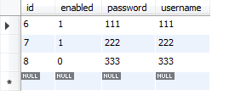
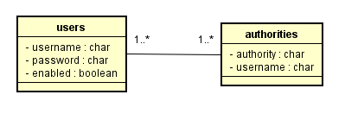
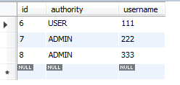
DB Design
Users : subject
Authorities : role

Slide 14
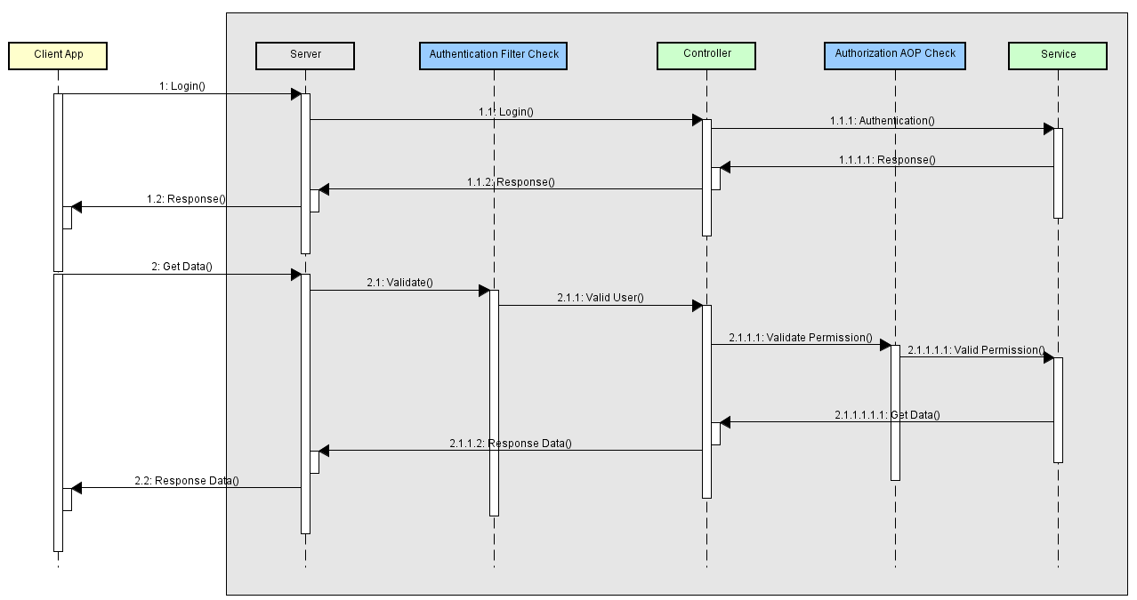
Flow Dirgram

Slide 15
Reference
https://en.wikipedia.org/wiki/Role-based_access_control
https://hitachi-id.com/documents/beyond-roles-a-practical-approach-to-enterprise-user-provisioning.php
http://csrc.nist.gov/groups/SNS/rbac/
http://docs.spring.io/spring-security/site/docs/4.2.2.RELEASE/reference/htmlsingle/
http://www.iteye.com/blogs/subjects/spring_security

